Slide 1



The Agile development
Omar al Yousuf
04/14/2021
Cs 250
Southern new Hampshire university

Slide 2



Scrum agile team roles
Product Owner
Scrum Master
Testers
Development Team

Slide 3
Product Owner
Responsible for the Return of Investment (ROI) of the product
Coordinates with Scrum Master and development team
Owns the Product backlog and writes user stories

Slide 4
Scrum master
Arranges and facilitates the team’s meetings such as daily scrums, sprint retrospectives, etc.
Ensure a good communication and relationship between the team and the product owner
Couching team members in self-management and cross functionality
Ensure all scrum events take place in timely manner
Helps the team understands the Product backlogs and any communication with the Product Owner.

Slide 5
Testers
Works with the Product Owner, Scrum Master, and the development team to ensure
the product moves in fast pace
Responsible for testing the user story cases and ensuring they pass
Collaborate with clients and development team to ensure requirements are met

Slide 6
Development Team
Holding themselves accountable as professionals
Development team has a combined skill sets necessary to create product increment
Turns the Product Backlog into increments and potentially a working product

Slide 7
Waterfall Process Phases
Requirements
Design
Implementation
Verification
Maintenance

Slide 8

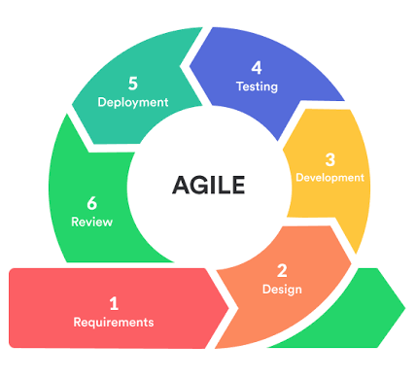
Scrum Agile Method Process

Slide 9
Agile Vs Waterfall Methodology
Agile
Waterfall
It is iterative and flexible method
Planning and decisions are done throughout the whole development process
Changes and updates can easily be implemented throughout the project lifecycle.
Testing is done concurrently throughout the project development
Client works exclusively with the project team which gives them sense of ownership
It is a process and structured method
Large amount of planning and decisions are done early in the development process
Changes are costly and might take times since it is done after project completion
Testing is done after the build phase
Client only works with the team at the requirement phase and to review the project at the end

Slide 10

Reference
Landau, P. (2020, October 19). Agile vs waterfall: What's the difference? How to use both methods. Retrieved April 18, 2021, from https://www.projectmanager.com/blog/agile-vs- waterfall?gclid=CjwKCAjwjuqDBhAGEiwAdX2cjyrb5mtUj3Tp6Ao3- RaHma_-VKQ2j2CoAQ-7xyrUZMMreP2VFsb-wBoC_60QAvD_BwE
What are the three scrum roles? (n.d.). Retrieved April 15, 2021, from https://www.visual-paradigm.com/scrum/what-are-the-three-scrum- roles/
What is a scrum master? (n.d.). Retrieved April 18, 2021, from https://www.scrum.org/resources/what-is-a-scrum-master

